Slide 1
Student Performance
Analysis and Predictions

Slide 2
About dataset
This dataset contains comprehensive information on 2,392 high school students, detailing their demographics, study habits, parental involvement, extracurricular activities, and academic performance. The target variable, GradeClass, classifies students' grades into distinct categories, providing a robust dataset for educational research, predictive modeling, and statistical analysis.

Slide 3
Table of Contents
Student Information
Student ID
Demographic Details
Study Habits
Parental Involvement
Extracurricular Activities
Academic Performance
Target Variable: Grade Class

Slide 4
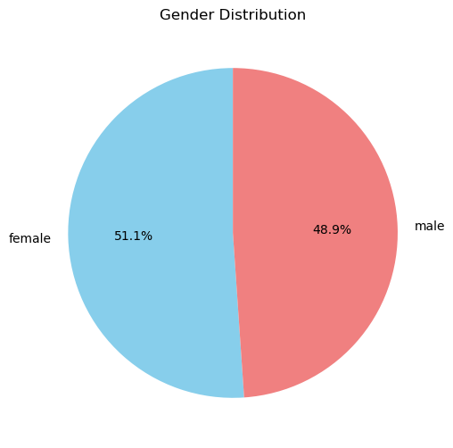
Gender distribution

Slide 5
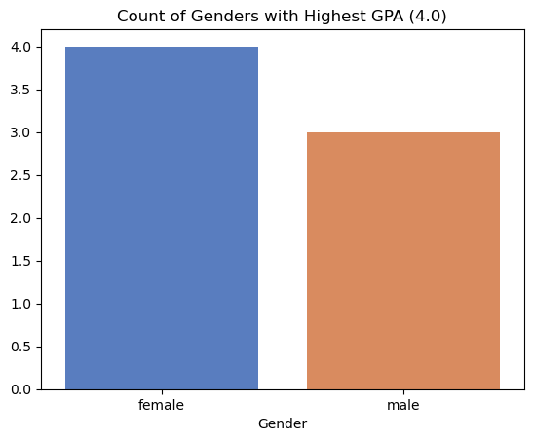
Count of genders with highest GPA

Slide 6
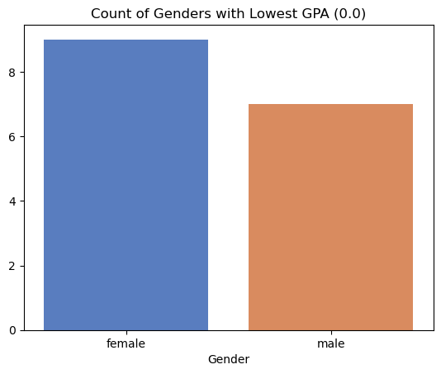
Count of genders with highest GPA

Slide 7
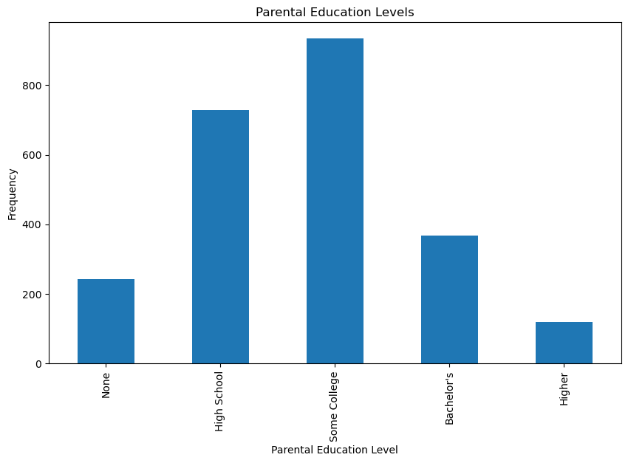
Parental Education Levels

Slide 8
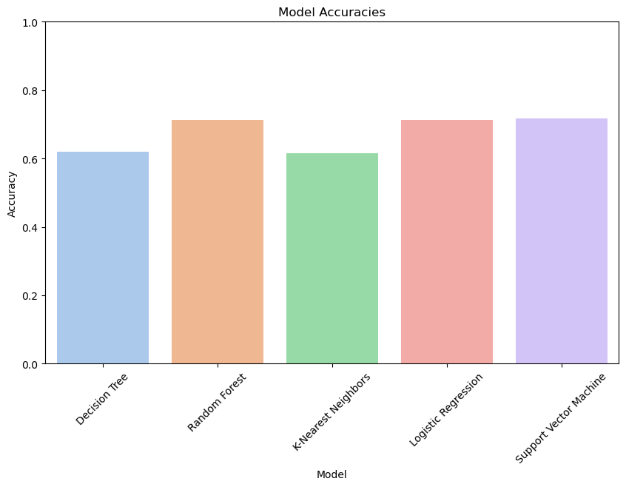
Evaluation

Slide 9
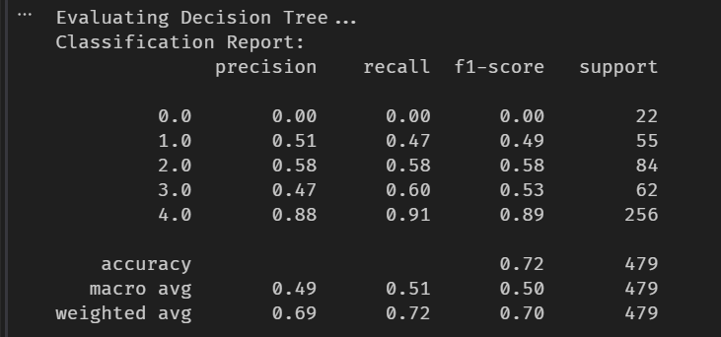
Decision tree

Slide 10

Random forest

Slide 11
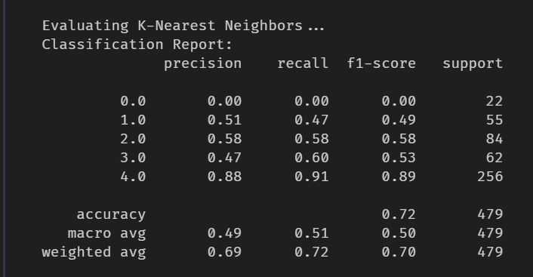
KNN

Slide 12
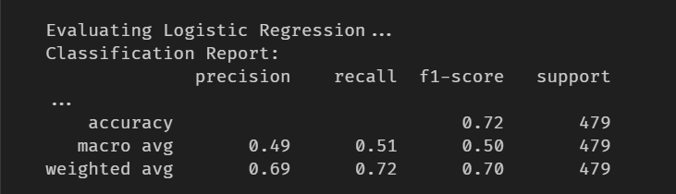
Logistic regression

Slide 13


